Slide 1

Medi - Assist
by
M. Swathi Reddy
Roll No. 204G1A05A9
Leena Sri
Roll No. 214G5A0507
C. Soumya
Roll No. 204G1A05A0
M. Parimala
Roll No. 204G1A0570
Under the guidance of
Mr. C. Sudheer Kumar M.Tech.(Ph.D)
Assistant Professor
Department of Computer Science and Engineering
Srinivasa Ramanujan Institute of Technology
(Autonomus)
2023 - 2024

Slide 2
Contents
Abstract
Problem statement
Objectives of Project
Literature survey for first objective
Literature survey for second objective
Proposed Work -(Methods to be followed for proposed system)
References
GitHub Link
Queries

Slide 3
Abstract
Human forgetfulness is a common occurrence, but should not be in the case of medicines where adherence is necessary for better treatment. Research indicates that lack of following the prescribed schedules results in substantial negative health implications and sometimes premature deaths caused by medication non-adherence.
To address all the issues, there is a need of developing a mobile application specially designed for managing the medications. The main objective of this application is to provide automatic medicine reminders by enabling doctors to prescribe medications directly through the application and this data is synchronized with the patient’s interface, ensuring accurate and real-time updates.
Keywords: Notification System, Automatic medicine reminder.

Slide 4
Problem Statement
Despite the availability of numerous reminder applications, patients occasionally encounter confusion regarding the administration of medication and certain instances of incorrectly set reminders may arise.
To address these challenges, this application offers a dedicated interface enabling doctors to establish comprehensive reminders including dosage instructions. Additionally, we monitor the timing of medication intake also.
The medication adherence can be improved which helps people lead a happy and healthy life.

Slide 5
Objectives of Project
Research Objective – 1: To help patients take their medications on time with the help of automatic medicine reminders. They can also include their family members to manage medications and if doses are missed despite multiple reminders, their family members get notifications regarding the same.
Research Objective – 2: To provide an interface where doctors can directly prescribe the medication which automatically gets updated in the patient interface.

Slide 6
Literature survey for first objective
In the existing reminder application, there are two significant modules in the application[1]. Set alarm is the first module, followed by Get Notification. The first patient who uses this application will receive a registration form. The patient must fill out a form with their name, mobile number, email address, gender, and password. However, the patient must be aware that the proper mobile number, email address, and password must be entered. Patient can log in using provided email address or mobile number in an application. If the patient provide wrong phone number that can result in the SMS reaching someone other than the patient.

Slide 7
Literature survey for second objective
Home based health care arrangement include communications, imaging, sensing and human computer interaction technologies[2]. The monitoring system uses the self-powering wireless environment with the help of renewable energy. The data from transmitter will be sending to cloud for centralized monitoring takes place, the expert in remote place can view all patient data and in case of emergency can take appropriate action. Buying all the equipment increases our budget. To address these challenges, we are proposing a cost effective mobile application which efficiently delivers pill reminders and increase patient medication adherence.

Slide 8
Proposed System
Our mobile application offers an interface that empowers doctors to directly issue prescriptions by associating them with patient IDs. This integration ensures synchronization with the patient application, triggering automated reminders to facilitate timely medication intake. As the reminder is set by the doctors themselves, it eliminates ambiguities regarding medication schedules and dosage instructions. Patient can also add their family members to observe the medication adherence. Furthermore, We also provide various functionalities like snooze reminders with personalized time settings, and even cancel doses as required which helps to track the medication in-take of the patients and a comprehensive medication history.
For data security and privacy concerns, our application provides end-to-end encryption ensuring sensitive medical data remains protected. In doing so, our application merges both technology and healthcare, furnishing a comprehensive solution for medication adherence and tracking.

Slide 9
References
[1]. S.A.Patil, Monika Bhanuse, Snehal Mali and Vishaka Swami , “Review on Mobile application for Medicine Reminder”, International Research Journal of Modernization in Engineering Technology and Science, Volume:03/Issue:02/February-2021.
[2]. Samir V.Zanjal and Girish. R. Talmale, “Medicine Reminder and Monitoring System for Secure Health Using IOT”, International Conference on Information Security and Privacy, December 2020.

Slide 10
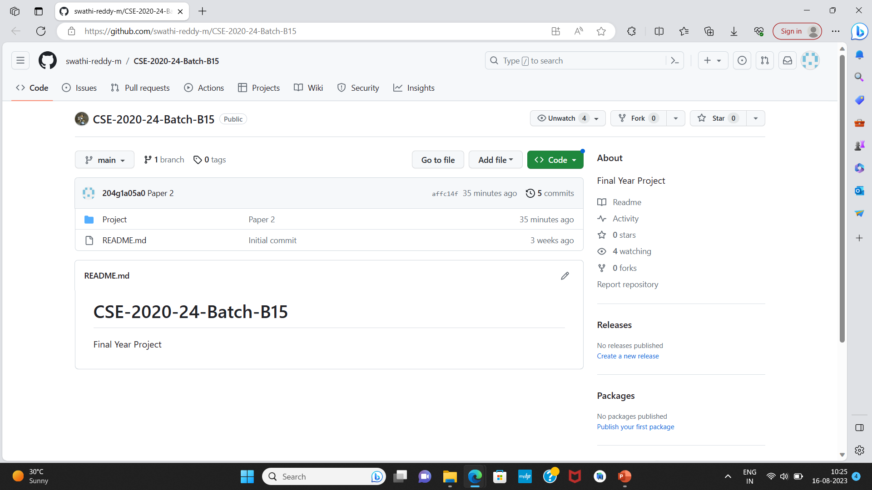
GitHub Dashboards of each student
GitHub Link : https://github.com/swathi-reddy-m/CSE-2020-24-Batch-B15

Slide 11
Any Queries..?

